Slide 1
Securing Content with Row Level Security

Slide 2
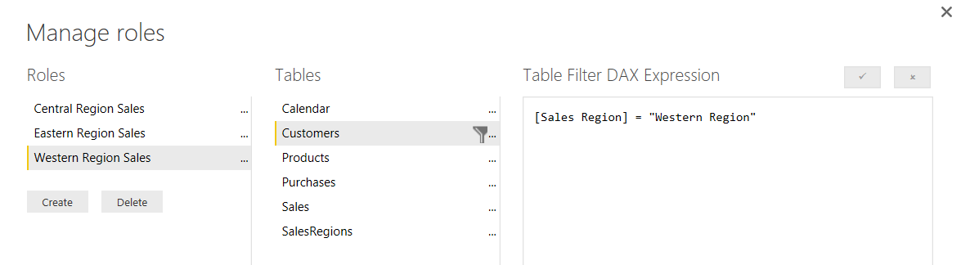
What Is Row-level Security (RLS)
Security Scheme based on Named Roles
Roles are defined using Power BI Desktop
Each role is scoped to the dataset within a PBIX project
Role defined using one or more DAX expressions
DAX expressions restrict which rows are accessible

Slide 3
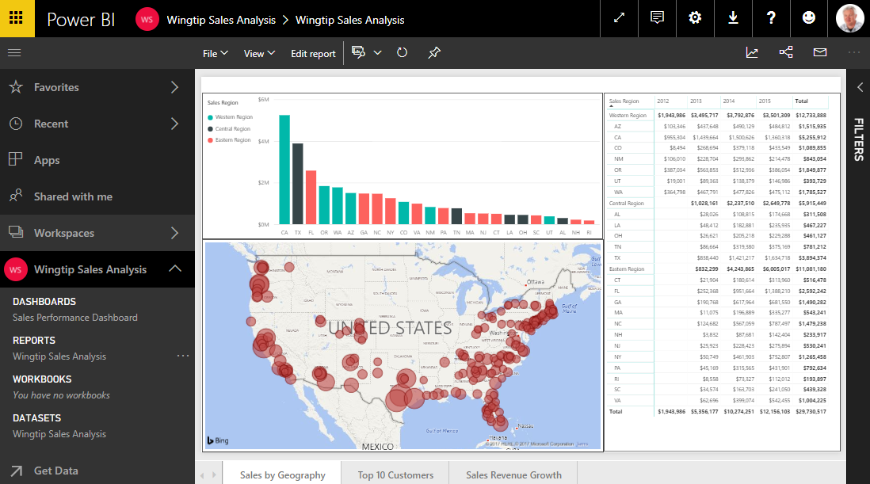
Common RLS Scenario

Slide 4
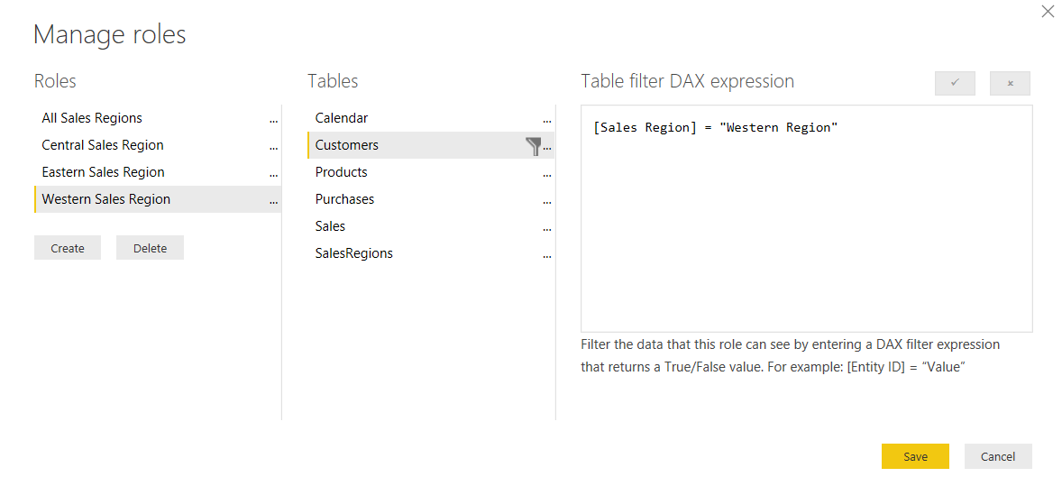
Configuring RLS in the Power BI Desktop

Slide 5
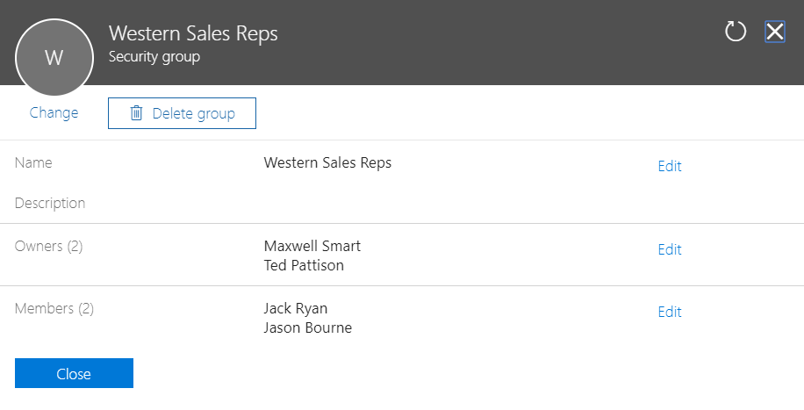
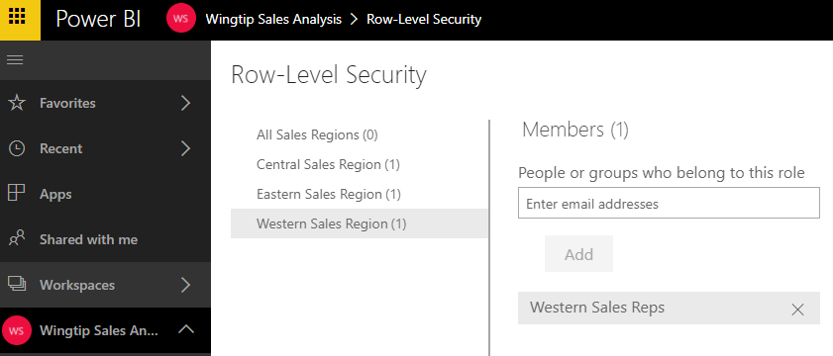
Configuring RLS in the Power BI Service

Slide 6
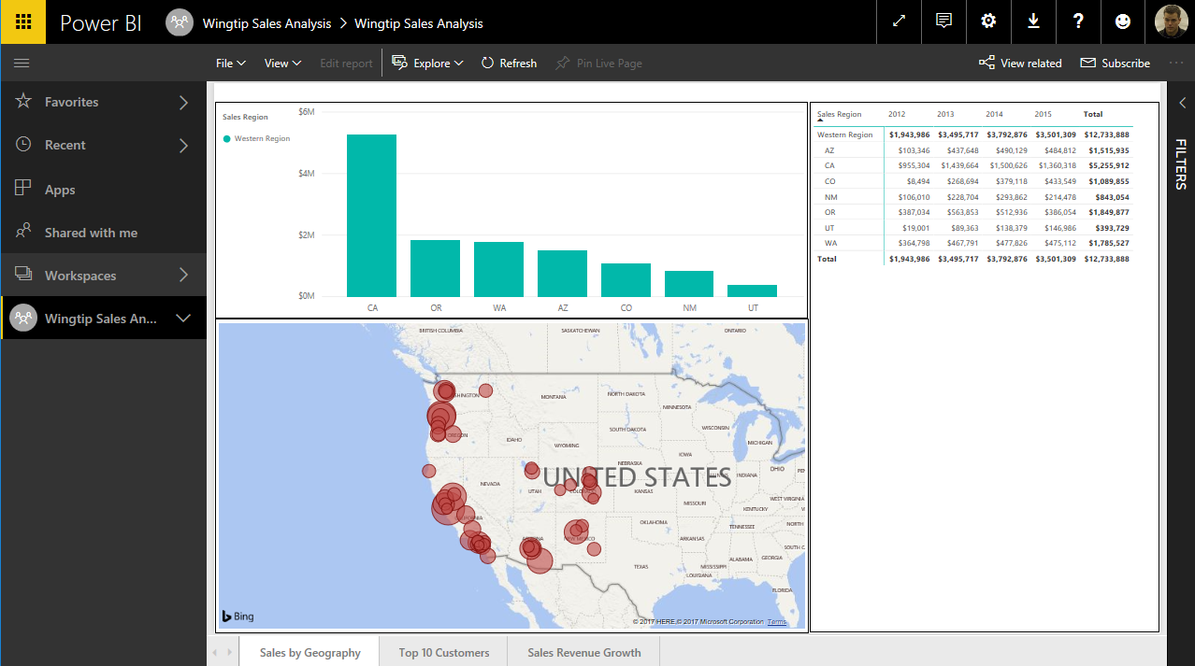
RLS Enforcement

Slide 7
Configuring Row-level Security

Slide 8
Agenda
Row Level Security
Dynamic Row Level Security
Embedding RLS-enabled Reports

Slide 9
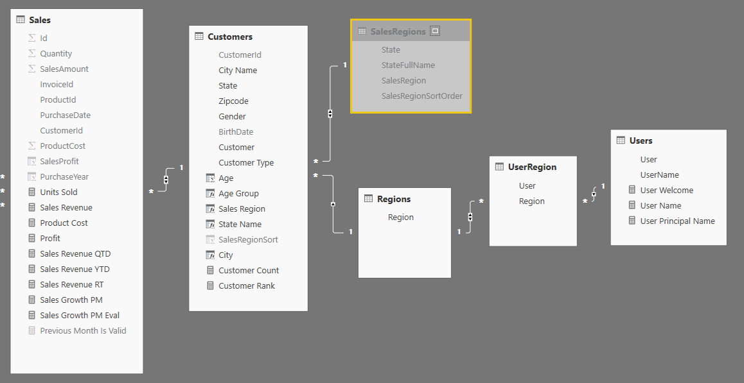
Dynamic RLS
Design pattern for data-driven security
RLS set up to use login name of current user
Permission assignments are included as part of dataset
Implemented using bi-directional cross-filtering

Slide 10
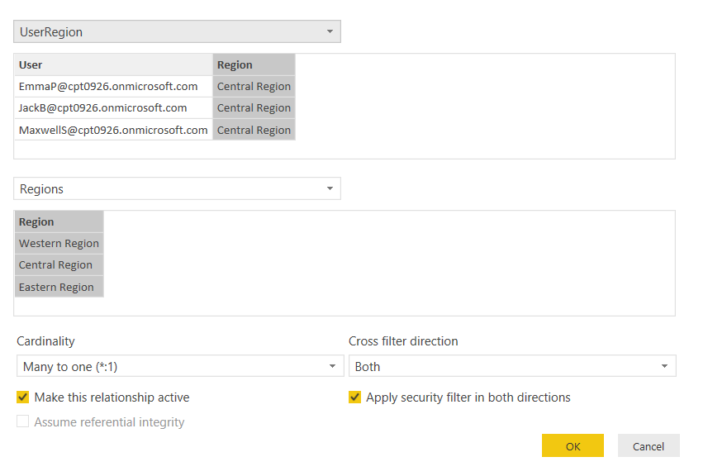
Configuring Cross-direction Filtering

Slide 11
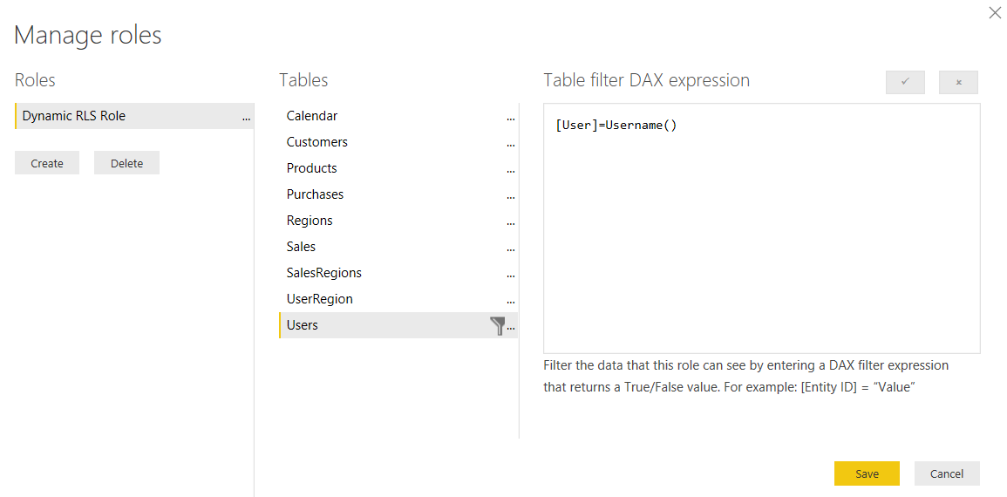
Dynamically Tracking the Current User

Slide 12
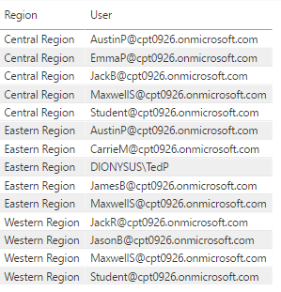
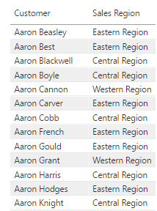
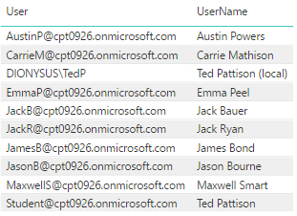

Dynamic RLS Table Filtering
UserRegion
Customers
Users
Regions

Slide 13
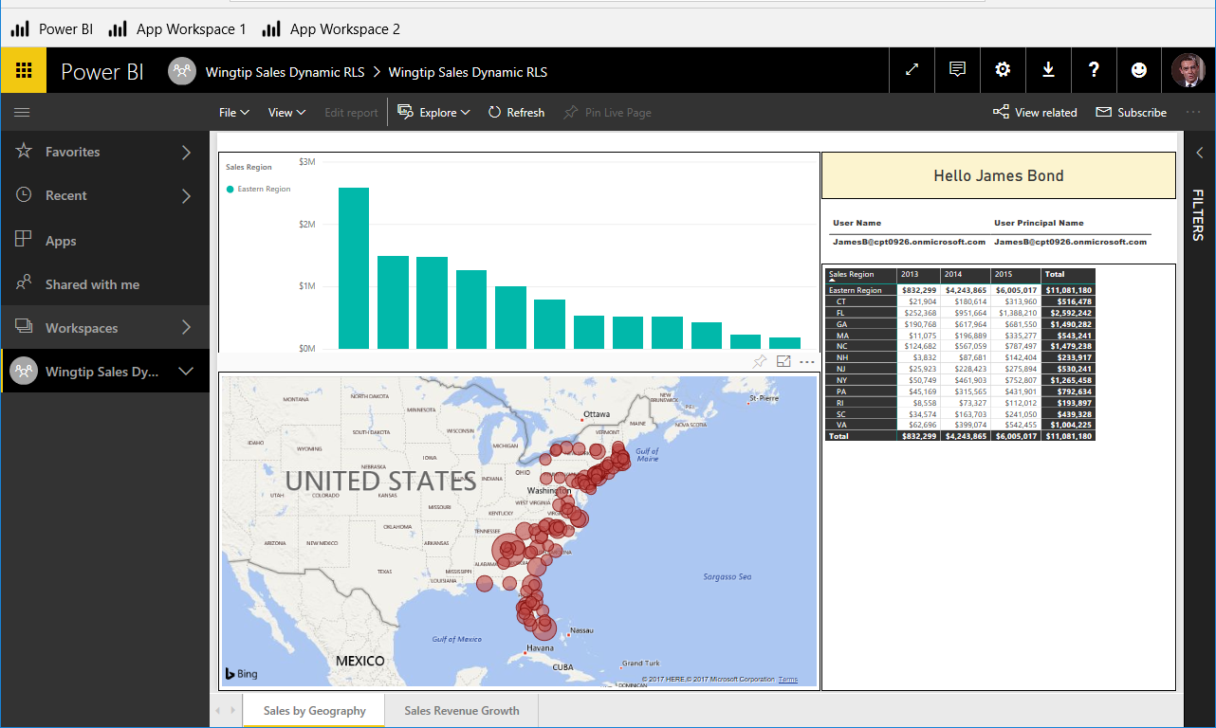
Dynamic RLS Enforcement

Slide 14
Configuring Dynamic Row-level Security

Slide 15
Agenda
Row Level Security
Dynamic Row Level Security
Embedding RLS-enabled Reports

Slide 16
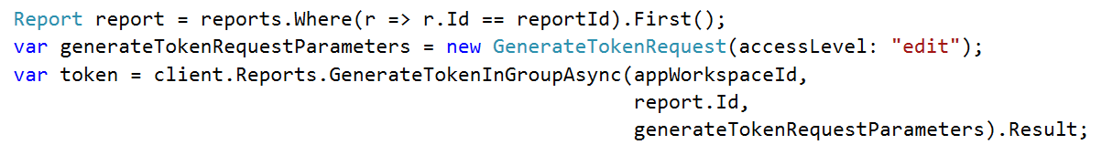
Generating Embed Tokens
App-Owns-Data embedding requires developer to generate embed tokens
Developer controls what permissions are extended to user for embedding purposes
Generating embed tokens requires dedicated capacity for any production scenarios
You generate embed tokens with the Power BI Service API
Embed Token V1 API used to create single resource embed tokens (see example below)
Embed Token V2 API used to create multi-resource embed tokens (see example in later slide)
Embed token provides restrictions on whether user can view, edit or create
Embed token can be generated to support row-level security (RLS)

Slide 17
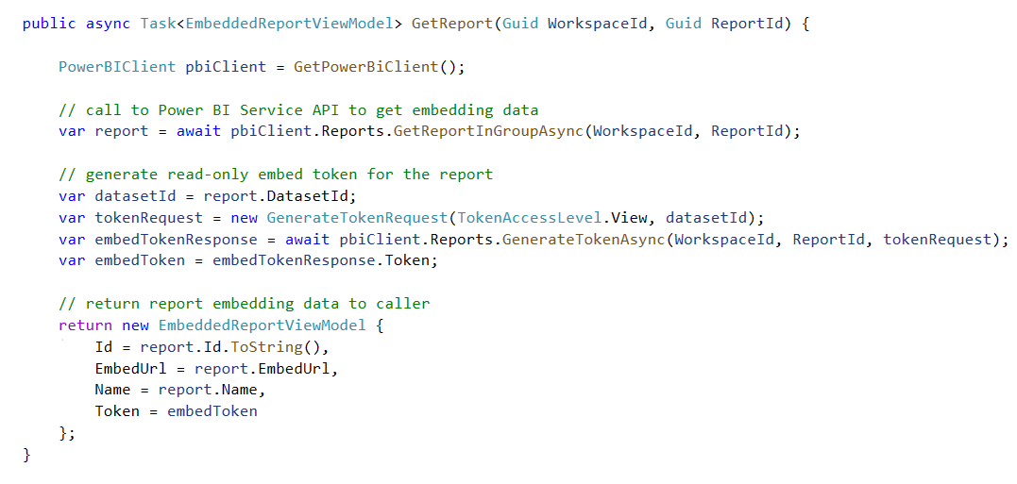
Getting the Data for Report Embedding

Slide 18
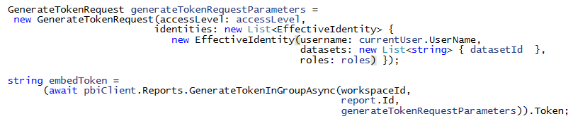
Embedding RLS-enabled Reports
Programming with EffectiveIdentity
RLS-enabled reports require role(s) for access
Embed tokens must be generated with 1 or more roles
Roles added to embed token using EffectiveIdentity

Slide 19
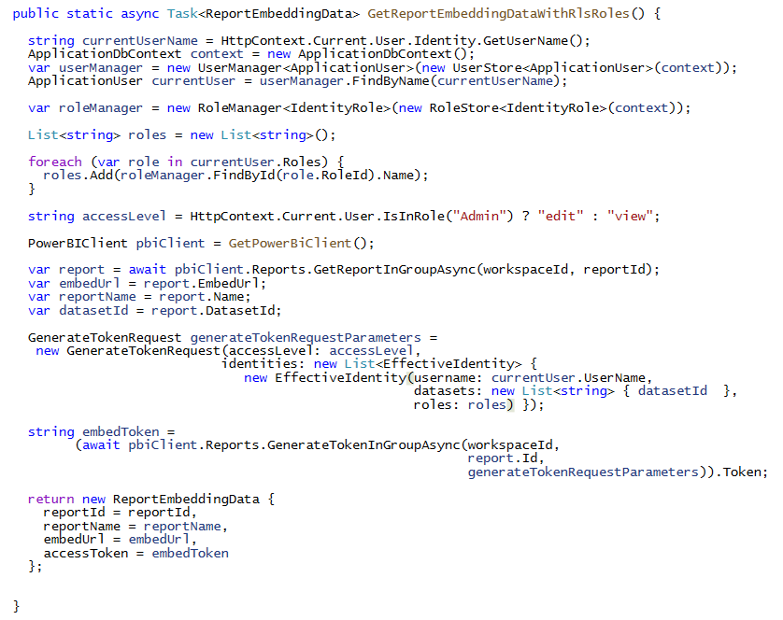
Programming with EffectiveIdentity - V1

Slide 20
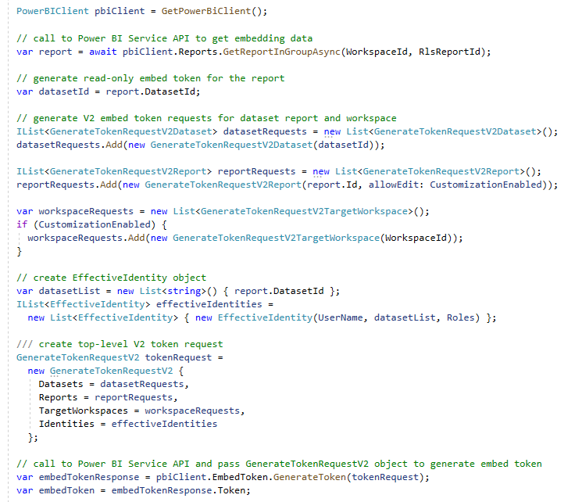
Programming with EffectiveIdentity – V2

Slide 21
Summary
Row Level Security
Dynamic Row Level Security
Embedding RLS-enabled Reports

